Slide 1
Data-Driven Optimization for Loan Approval Process
Presented by: Miguel Polanco
Date: 13th August 2024
Notes:
Welcome everyone. My name is Miguel Polanco, and today I will be presenting my capstone project titled 'Data-Driven Optimization for Loan Approval Process.
The financial sector is increasingly competitive, and making informed, data-driven decisions is more crucial than ever.
Our focus today is on how we can leverage data to optimize the loan approval process, ultimately benefiting both the bank and its customers.

Slide 2

Executive Summary
In the fast-paced world of finance, the ability to make informed, data-driven decisions is more crucial than ever. This presentation explores how leveraging data can optimize the loan approval process, leading to smarter decisions that benefit both the bank and its customers.
Advanced machine learning techniques have uncovered the key variables that most influence whether an applicant is approved or not. These insights have the potential to refine processes, streamline operations, and ultimately enhance customer satisfaction.
This Photo by Unknown Author is licensed under CC BY-NC
Notes:
To start, let me provide an overview of the project. In today’s fast-paced financial environment, the ability to make data-driven decisions is critical. We’ve applied advanced machine learning techniques to the loan approval process, revealing the key variables that most influence whether an applicant is approved or not. By refining these processes, the bank can streamline operations, reduce costs, and enhance customer satisfaction."

Slide 3





Topics of Discussion
1. Business Opportunity
2. Data Exploration and Insights
3. Predictive Models
4. Model Selection and Insights
5. Recommendations and Next Steps
Notes:
Our agenda today covers five key areas. First, we'll discuss the business opportunity, and the challenges faced by traditional loan approval processes. Next, we’ll explore the data used in this project and the insights derived from it. Then, we will dive into the predictive models that were tested and the rationale behind model selection. Finally, we’ll wrap up with the impact on the business and some recommendations for moving forward.

Slide 4

Business Opportunity
The traditional loan approval processes in banking are riddled with inefficiencies, largely due to their reliance on manual document verification and subjective judgment.
A major challenge faced by banks is the prolonged turnaround time for loan approvals.
The operational costs associated with traditional loan processing are substantial.
Notes:
Traditional loan approval processes are loaded with inefficiencies, primarily due to manual document verification and subjective judgment. This not only increases turnaround time but also incurs into substantial operational costs. In a competitive market, these inefficiencies can lead to customer dissatisfaction and lost business opportunities.

Slide 5

Business Opportunity
This situation presents a significant business opportunity to innovate by adopting advanced, data-driven approaches to loan approval.
By automating key stages of the process, banks can reduce operational costs, improve efficiency, and provide quicker, more accurate loan approvals.
Notes:
These inefficiencies not only frustrate customers but also hinder our ability to scale and compete. By adopting a data-driven approach, we can significantly improve efficiency, reduce costs, and provide quicker, and more accurate loan approvals.

Slide 6

Data Exploration and Insights
Data consists of 381 observations and 13 variables.
Variables consist of applicant's personal information, financial information and loan requested information.
Data is distributed in an 80:20 relationship, 80% test data and 20% validation data.
Notes:
Our analysis is based on a dataset consisting of 381 observations and 13 variables. These variables include a range of applicant information, including personal, financial, and loan-related details, which we used to predict whether a loan would be approved or rejected. The data was split into an 80:20 ratio, with 80% used for training and 20% for validation.

Slide 7
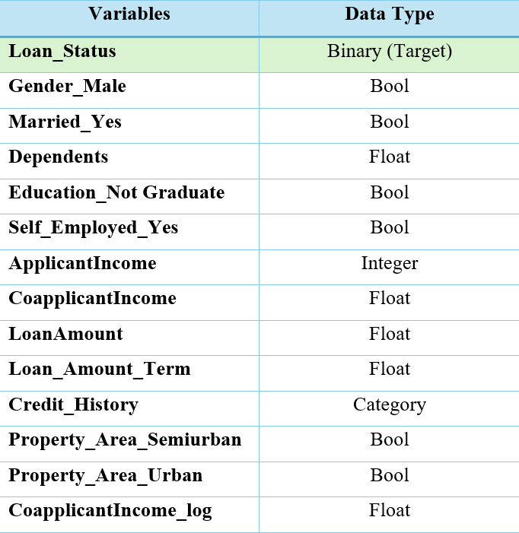
Data Exploration and Insights
Binary target variable: Loan Status (Y or N)
Data cleaning: Replacing missing values, management of outliers and minimizing skewness for variables.
Removed Data from exclusion: Loan_ID (ID)
Notes:
To prepare the data for modeling, we performed several key steps, including handling missing values, removing irrelevant variables, and minimizing variables skewness with transformations. This process ensured that our data was clean and ready for accurate analysis. Proper data preparation is critical as it directly impacts the performance of the models and the reliability of the predictions.

Slide 8
Predictive Models
Decisions Tree
Average Squared Error (ASE)
Full Misclassification
Logistic Regressions
Grid Search
Full Logistic Regression
Forward Logistic Regression
Backward Logistic Regression
Stepwise Logistic Regression
Random Forest
Gradient Boost
Notes:
We tested several predictive models, including Decision Trees, Random Forest, Gradient Boosting, and Logistic Regression, in various configurations. Each model was evaluated based on its ability to accurately predict loan approvals, with particular attention paid to metrics like ROC-AUC score and accuracy. The goal is to identify the model that could deliver the most reliable and efficient results.

Slide 9
Model Selection and Insights
Model | ROC-AUC Score | Accuracy
Random Forest with Best Features | 0.82 | 0.77
Random Forest | 0.82 | 0.75
Full Logistic Regression | 0.81 | 0.75
Forward Logistic Regression | 0.80 | 0.77
Gradient Boost | 0.78 | 0.73
Stepwise Logistic Regression | 0.71 | 0.74
Forward Logistic Regression | 0.71 | 0.74
Grid Search Decision Tree | 0.71 | 0.74
Decision Tree ASE | 0.67 | 0.69
Full Misclassification Tree | 0.61 | 0.64
Notes:
After a rigorous evaluation, the Random Forest model emerged as the top performer with a ROC-AUC score of 0.82 and an accuracy of 77%. This model was refined by focusing on the most impactful features, leading to a slight but significant increase in accuracy.

Slide 10

Model Selection and Insights
Random Forest with best features: Re-run of the original model but with less variables. The reduction in variables led the model to achieve a 2% gain in accuracy from the original model.
Reduction in costs and time saving as less information is needed in the application process for loan approval.
By focusing on the most impactful variables and refining the model to enhance accuracy, the company is well-positioned to optimize its loan approval operations.
Notes:
Let me explain why this model stood out. The Random Forest algorithm is an ensemble learning method that builds multiple decision trees and merges their predictions to improve accuracy and control overfitting. In our case, the Random Forest model achieved a ROC-AUC score of 0.82, indicating a strong ability to distinguish between approved and rejected loans. Additionally, the model had an accuracy rate of 77%, meaning that 77% of the time, it correctly predicted whether an applicant would be approved or rejected.
What's particularly noteworthy is how we optimized the model by focusing on the most impactful features. Originally, the model used a broader set of variables, but by narrowing it down to the best-performing ones, we achieved a 2% gain in accuracy. This refinement not only made the model more efficient but also simplified the input data requirements. The fewer variables we need, the less information we require from applicants, which can reduce the time and cost of the approval process.

Slide 11
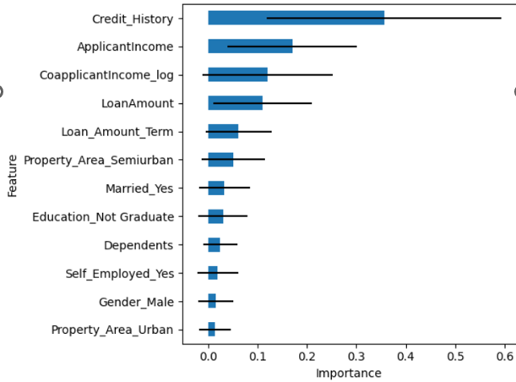
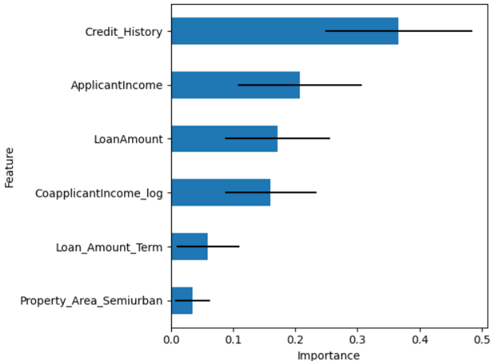
Model Selection and Insights
Random Forest
Random Forest with BF
Notes:
The selected model identified several key features that significantly impact loan approval decisions. The most critical features are the applicant’s credit history, followed by the applicant’s income, the requested loan amount, and the co-applicant’s income.
For Credit History, the variable had the highest level of importance, with a score of 0.37. The model shows that applicants with a credit history are substantially more likely to be approved for a loan. This makes sense, as credit history is a strong indicator of an applicant's ability to repay the loan.
The income of the primary applicant was the second most important feature, with a score of 0.21. However, the odds ratio analysis from the full logistic regression, which was the runner up for best model, indicated that while income does play a role, the increase in the likelihood of approval with higher income is minimal, suggesting that other factors weigh more heavily in the decision-making process.
For the Loan Amount, this feature had an importance score of 0.17. Interestingly, the model shows that as the loan amount increases, the likelihood of approval slightly decreases. This finding can be explained by taking into consideration that larger loans represent a higher risk to the bank.
Finally, the log-transformed income of a co-applicant was also a significant predictor, with an importance score of 0.16. The odds ratio suggests that higher co-applicant income moderately increases the chances of loan approval.
These insights provide a clearer understanding of what factors are most critical in determining loan approvals, allowing us to refine our decision-making processes and improve the accuracy of our predictions.

Slide 12



Model Results Impact on Business
Operational Efficiency for the Loan Application Process
Risk Management and Improvement of Loan Portfolio
Targeted Marketing to Lower Risk Applicants
Customer Segmentation for Joint Applicants
Notes:
The Random Forest model offered valuable insights that can significantly enhance our business operations.
First, operational efficiency: So, by focusing on key features like credit history and income levels, we can simplify the loan application process. The model’s 2% accuracy gain with fewer variables suggests we can streamline data collection, reducing both complexity and operational costs.
The importance of a credit history is clear. Prioritizing applicants with credit histories can lower default rates and strengthen our loan portfolio, ensuring more secure lending decisions.
The model indicates that higher loan amounts decrease approval odds. This insight allows us to tailor loan products to lower-risk customers, improving approval rates and customer satisfaction by aligning products with their financial capabilities.
Lastly, customer segmentation for Joint Applicant: The positive impact of co-applicant income suggests the promotion of joint applications, especially for those with higher combined incomes. This approach can boost approval rates and expand our customer base.

Slide 13

Recommended Next Steps
Implementation of Automation for Loan Application Process
Integration of Stricter Credit History Protocols
Marketing Strategies for Joint Loans and Low-Risk Applicants
Notes:
To capitalize on the insights from this project, I recommend the following actions:
We should implement the Random Forest model as the core of our new automated loan approval system. By doing so, we can streamline the decision-making process, reduce the time required to approve loans, and minimize human error.
Given the importance of credit history in the loan approval process, we should integrate stricter credit history evaluation protocols. This will help us better assess the risk associated with each applicant and make more informed decisions.
With the insights gained from the key features, we can develop targeted marketing strategies for loan products. For example, by offering joint loans to applicants with a strong co-applicant income, we can tap into a segment of the market that is likely to have higher approval rates and lower risk.
Finally, we should continue to refine our models by incorporating additional data sources and exploring other advanced machine learning techniques. This will allow us to stay ahead of market trends and continuously improve the accuracy of our predictions.

Slide 14
Thank You!
Notes:
Thank you for your attention, and I’m now open to any questions you may have.

Slide 15
Appendix

Slide 16
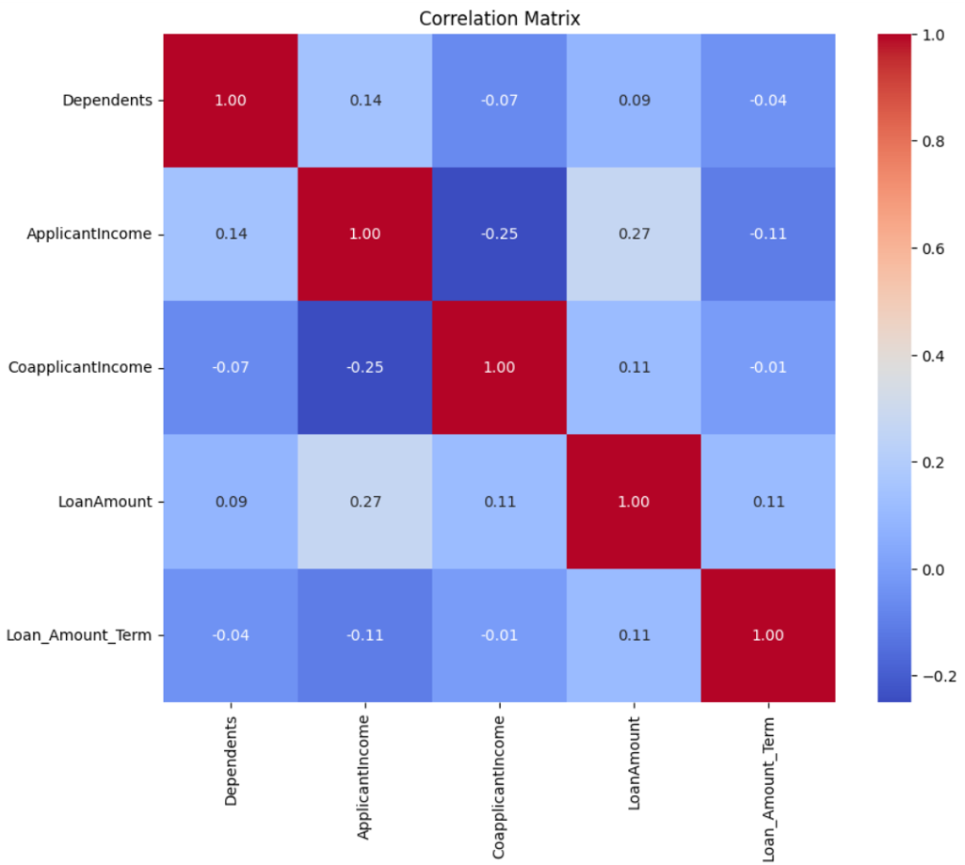
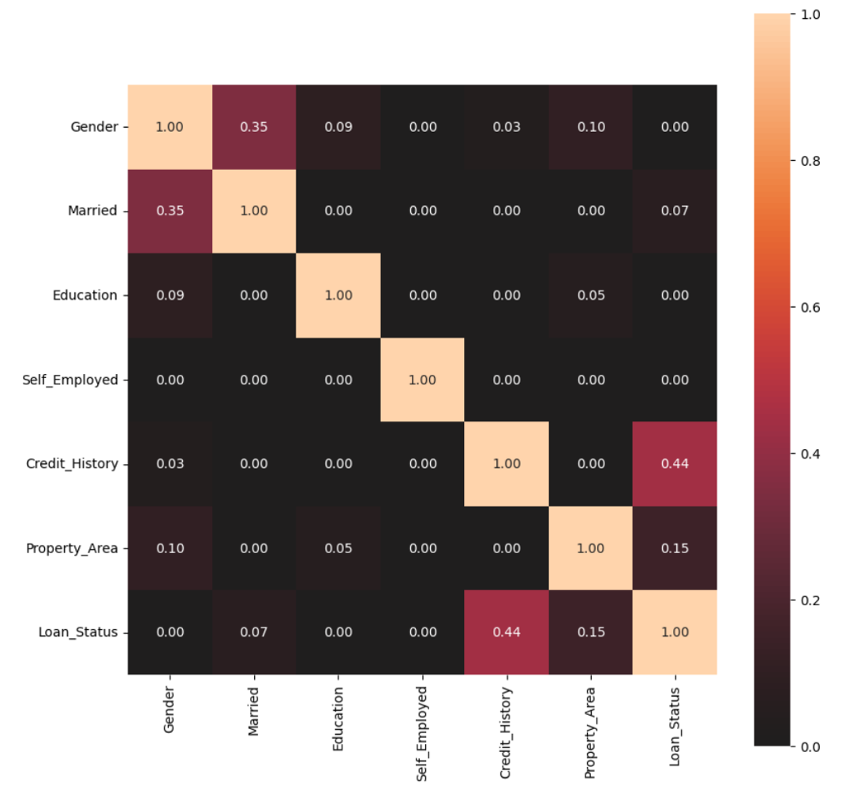
Correlation Matrix

Slide 17
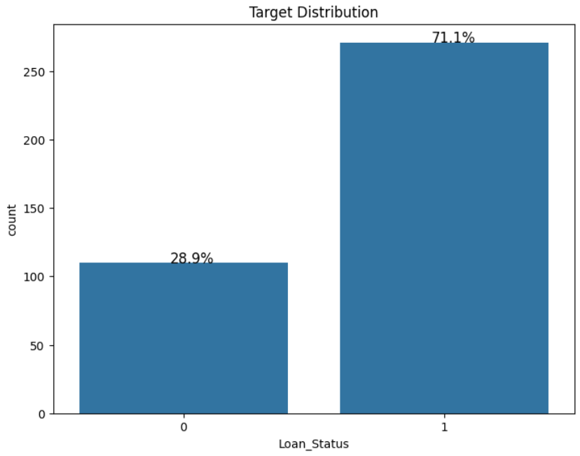
Target Distribution

Slide 18
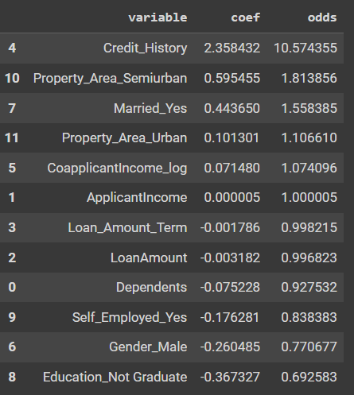
Full Logistic Regression Odds Ratio

Slide 19
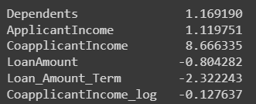
Variables Skewness

